Slide 1


Ayiti Analytics Data Processing Bootcamp
Due Friday, June 23th at 1:00pm

Slide 2
Problem
❏ The business problem
❏ The stakeholders impacted by the problem
In an effort to attract and integrate more professionals in the field of data science, Ayiti Analytics decided to expand its program to more municipalities. For the 2021, they have received applications from all over the country. Based on this data, they want to organize the program in other communes, but which ones?
The Ayiti Analytics team
The interested applicants
The society

Slide 3

Problem
❏ The importance of the problem for the organization
Ayiti Analytics wants to expand its network in the whole country. He believes that the data science method to solve the problems of our communities could be very effective. That's why they want to have as many people as possible but especially in different communities. In this state of affairs, they will be able to diversify their projects and all of their activities in different places in the country.

Slide 4
Methodology
The methods and data sources used for the analysis
The data was collected on the website of Ayiti Analytics from the people who filled in the form and enrolled in the introductory courses. We had seven datasets to extract the data that could help solve the problem the best way.
Python is used through its different libraries to clean, do exploratory data analysis and perform inferential statistics.

Slide 5
Univariate Analysis
Applicants by sex
Sex
Sex | Count | Frequency in %
Male | 203 | 81
Female | 47 | 19
Men are overrepresented, there are 4 times more men than women who apply. Inequality between men and women in technological fields in Haiti explains this trend.

Slide 6
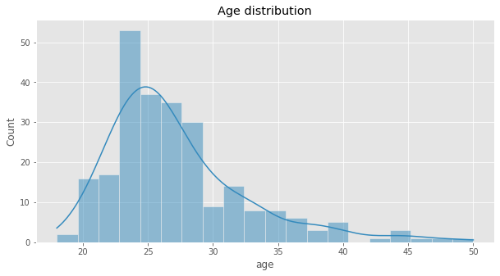
Univariate Analysis
Age distribution
Most of the applicants are under 30 years old, we can say in particular that those aged from 22 to 28 years are very represented and are very interested in data science.

Slide 7
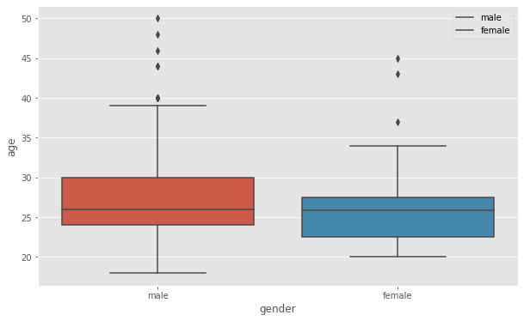
Univariate Analysis
Age distribution
The age distribution of men and women does not differ greatly. The The median is almost identical and would be around 28 years.

Slide 8
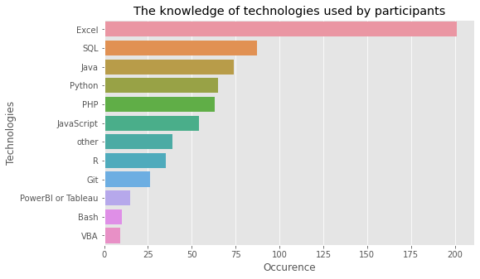
Univariate Analysis
Technologic tools by applicants
Excel is the most used tool among the applicants.

Slide 9
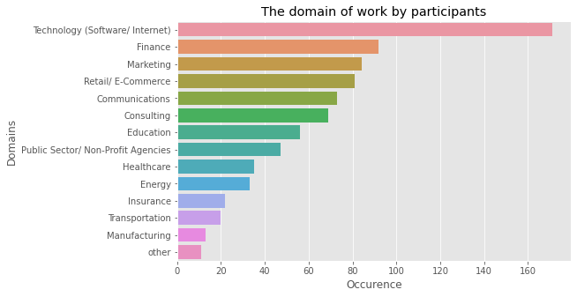
Univariate Analysis
Domains of work by applicants
Technology(software/internet) and finance seem to be the domains of work most found among the applicants.

Slide 10
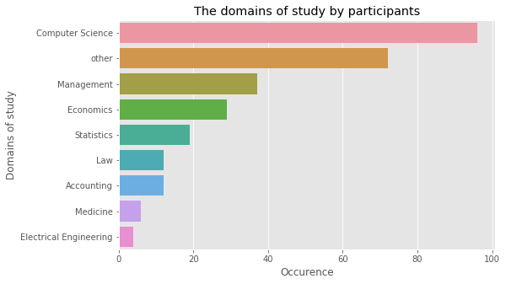
Univariate Analysis
Domains of study by applicants
Computer science are the domain of study better represented. We know how much diversity is important for AA.

Slide 11
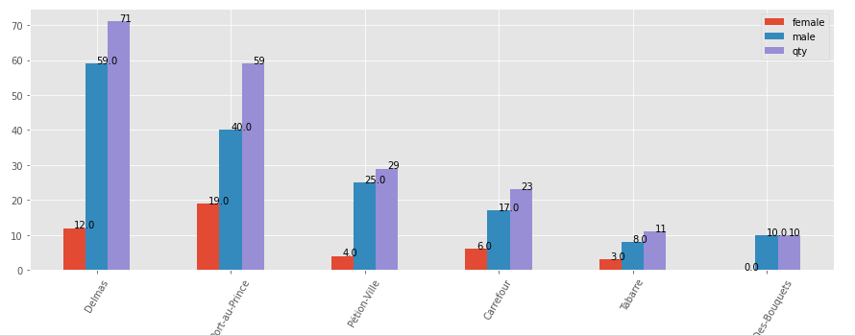
Bivariate Analysis
Sex distribution among communes

Slide 12
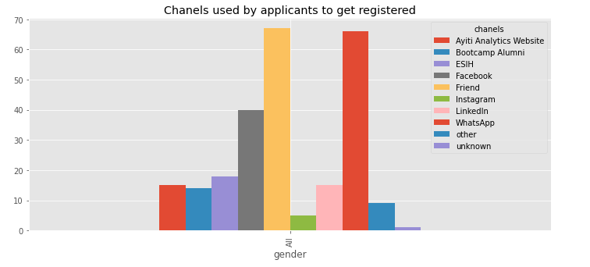
Bivariate Analysis
Registrations evolution by week
The best chanels to use to attract applicants are Friends and Whatsapp, we can say that way of the way to get more is to use networking. This does not mean that the best channel for all applicants is the same for each gender independently. We know how much AA want to reduce the inequality between men and women in Data Science Domain.

Slide 13
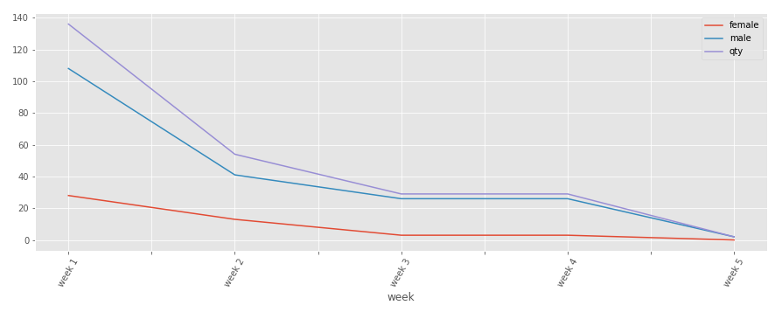
Bivariate Analysis
Registrations evolution by week
We can see from this graph that increasing the number of days will not increase the number of registrations, the best strategy would be to use the most used channels to attract the most applicants.

Slide 14
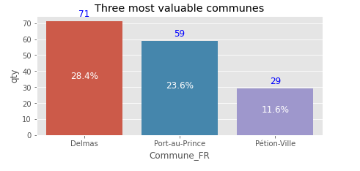
Results
Three municipalities with 30 students
We could consider them beacause we suppose that no bootcamp have been already done anywhere.
The number of applicants per municipality remains the most important criterion since the municipality must have at least 30 people. However, we could take an applicant from a neighboring commune.

Slide 15
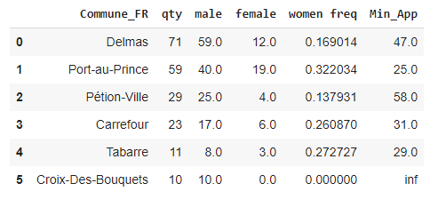
Results
The minimum number of applicants required to ensure that there are at least 8 (25%) women for each municipality.
Based on the frequency of women for each municipality, we calculate the number of people who must register at least for us to have 25% women, the variable Min_App give this number.

Slide 16
Results
The most effective communication channels (Alumni, Facebook, WhatsApp, Friend ...) that will allow a student to be susceptible to selection
The best channels to use to attract applicants are Friends and Whatsapp, 53.2% of applicants come from those channels. We can say that way of the way to get more is to use networking. This does not mean that the best channel for all applicants is the same for each gender independently. We know how much AA want to reduce the inequality between men and women in Data Science Domain.

Slide 17
Results
The most effective communication channels (Alumni, Facebook, WhatsApp, Friend ...) that will allow a women to be susceptible to selection
We could not assert that a channel is favorable to a gender without testing the dependence between the channels used for the applications and the gender.
We perform a chi-square test of independence to test if emphasizing a channel will increase the number of applications.
The p-value : 0.0055< 0.05, so With a significance level of 0.05,
we can therefore conclude that the association between the variables Gender and Channels is statistically significant.
We can propose to see the specific channels to encourage women to apply.

Slide 18
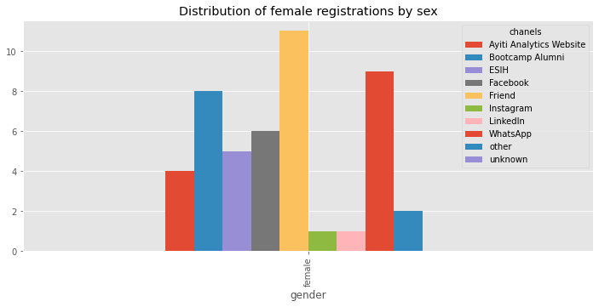
Results
The most effective communication channels (Alumni, Facebook, WhatsApp, Friend ...) that will allow a women to be susceptible to selection
If we use the others, we'll get more men because they attract men more tan women. The more efficient chanel that could attract women more than men is Bootcamp Alumni. The women are most likely confident to people who have been through the experience.

Slide 19
Results
The average number of university students who should participate in this program.
20.0 is the number of applicants, university students we should have with this assumption.
We assume that the same proportion of university applicants will be admitted to the program. 65.2% of the applicants are at least university students.

Slide 20
Results
The average number of applications per week that we could have
If we should receive the same amount of applicants every week, we would have received 50.
We can see from in previous graph that increasing the number of days will not increase the number of registrations, the best strategy would be to use the most used channels to attract the most applicants.

Slide 21
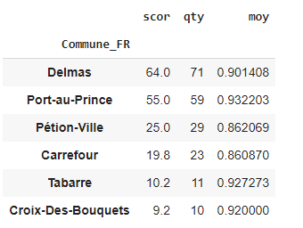
Results
If we were to do all the bootcamp online, the best communes and how many applications would we need to select 30 student and what percentage of students would have a laptop, an internet connection, both at the same time
Scores for each individual based on whether or not they have a computer at home and whether or not they have access to the internet are calculated. We show the score for the top five commune with more applicants, we find that Port au Prince, Tabarre and Croix-des-Bouquest. We do not take the 30 person criterion as relevant given the virtual aspect. Since the bootcamp will be conducted online, it is not at all important to take into account the residence of the applicant. We take it as long as it is technically equipped no matter where he is located

Slide 22
Discussion & Proposed Solution
Solution: Do two bootcamps in the two most represented municipalities and another one mainly online for the other applicants who have computers and internet at home.
Strength: Ayiti Analytics will extend its program outside the metropolitan area, so that people who do not live in these municipalities will have a chance to enter the field of data science.
Weakness: It will be more difficult to track each student online and follow their progress. The covid-19 and socio-political crisis can block the continuity of the in presence bootcamp.

Slide 23
Discussion & Proposed Solution
Solution: Do two bootcamps in the two most represented municipalities and another one mainly online for the other applicants who have computers and internet at home.
Opportunity: It will be able to expand his network throughout the country. In total for all municipalities, 202 applicants have both computer and internet at home home. If we implement this solution we will have 202 with laptop and internet students from which we can choose the best ones to represent Ayiiti Analytics in all departments of the country.
Threat: The management of all these people could be difficult, especially when it comes to placing them in internships.

Slide 24
References & Appendices
Github Account
Wedsanley/Data-processing-Mini-Project: Data Processing course, final project. (github.com)

